Slide 1
Stanford ME469: Nalu Overview
Stefan P. Domino
Computational Thermal and Fluid Mechanics
Sandia National Laboratories SAND2018-4619 PE

Slide 2
Nalu Overview: Outline
Nalu Technology Origination: ASC
Beyond the 32-bit Limit
Supported Physics
Supported Numerics
Low- and High-order
Moving Mesh (Sliding and Overset)
Multiphysics:
Fluid Structure Interaction
Conjugate Heat Transfer (CHT)
Participating Media Radiation
Examples
Conclusion

Slide 3
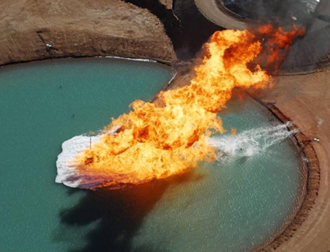
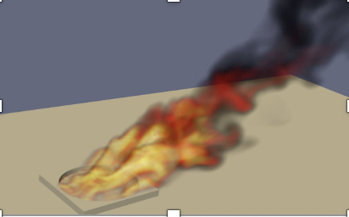
Core Technology Provided to Nalu Origination: Advanced Simulation and Computing Sierra/Fuego
Use-case characterized by a highly sooting, turbulent, reacting flow with Participating Media Radiation (PMR), Conjugate Heat Transfer (CHT), and propellant multi-physics coupling
Complex geometry has driven a generalized, hybrid unstructured discretization approach supporting Hex8, Tet4, Wedge6, and Pyramid5 elements in addition to arbitrary promotion of Hex8 to Hex27, Hex64, etc.

Slide 4
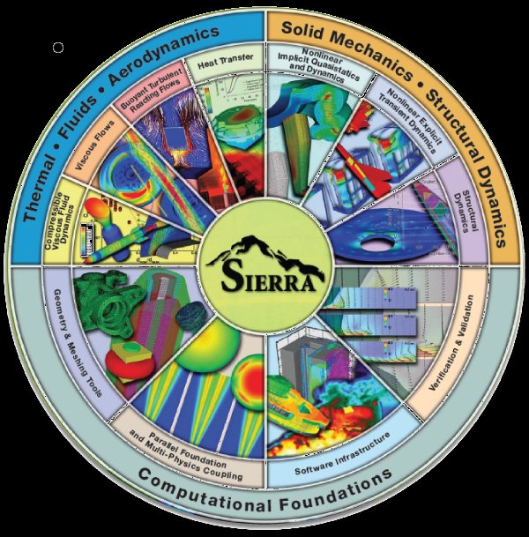


Goal: Beyond 32-bit Computing
Circa 2013, many scientific production codes were limited to 32-bit
Therefore, maximum simulation size for entities, e.g., node, edge, face, element, etc., was ~2.2 billion
Next Generation Platforms were advocated to overcome poor MPI scaling and power needs to support Exascale computing (10¹⁸ floating point operations/second)
Platform architectures, at that point, were not not yet known (still evolving)
+ ASC IC
Investments
( )
Sierra Toolkit/Trilinos (open-source)
MPI+X parallelism
Support for new architectures

Slide 5
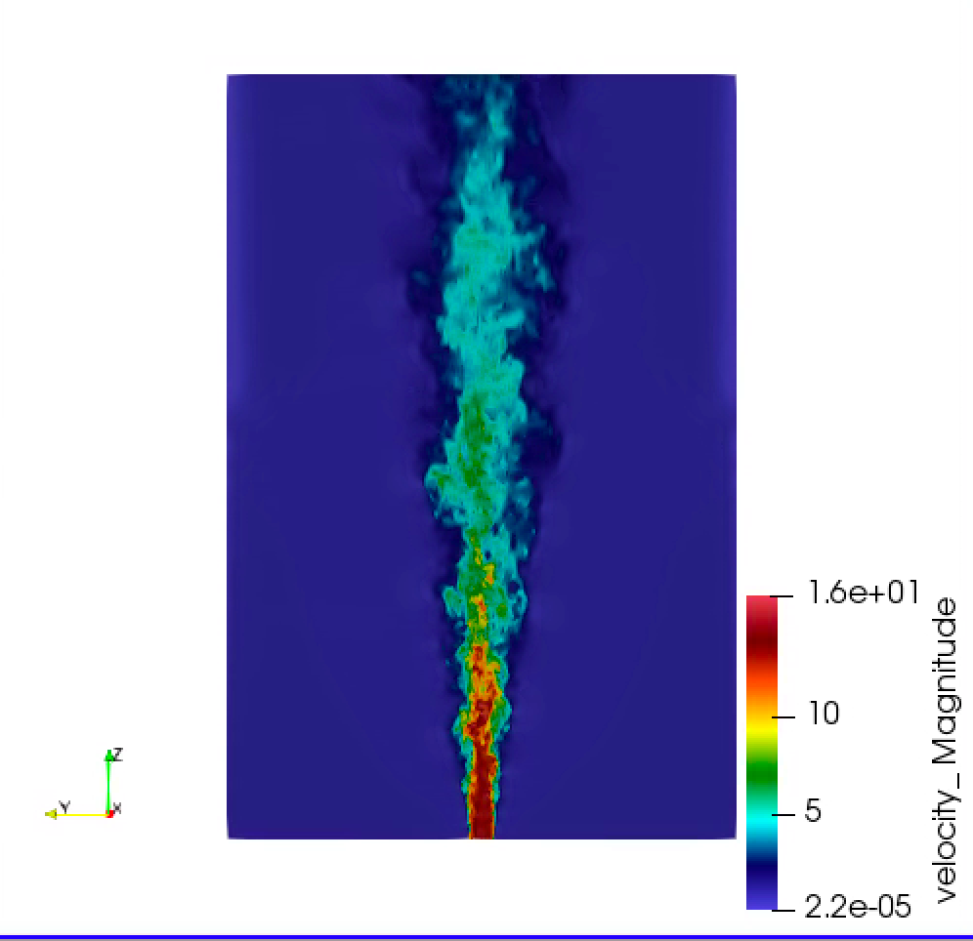


Developed Open-Source BSD-clause 3 Distribution Policy
Philosophy: Open-source collaborations
https://github.com/NaluCFD

Slide 6
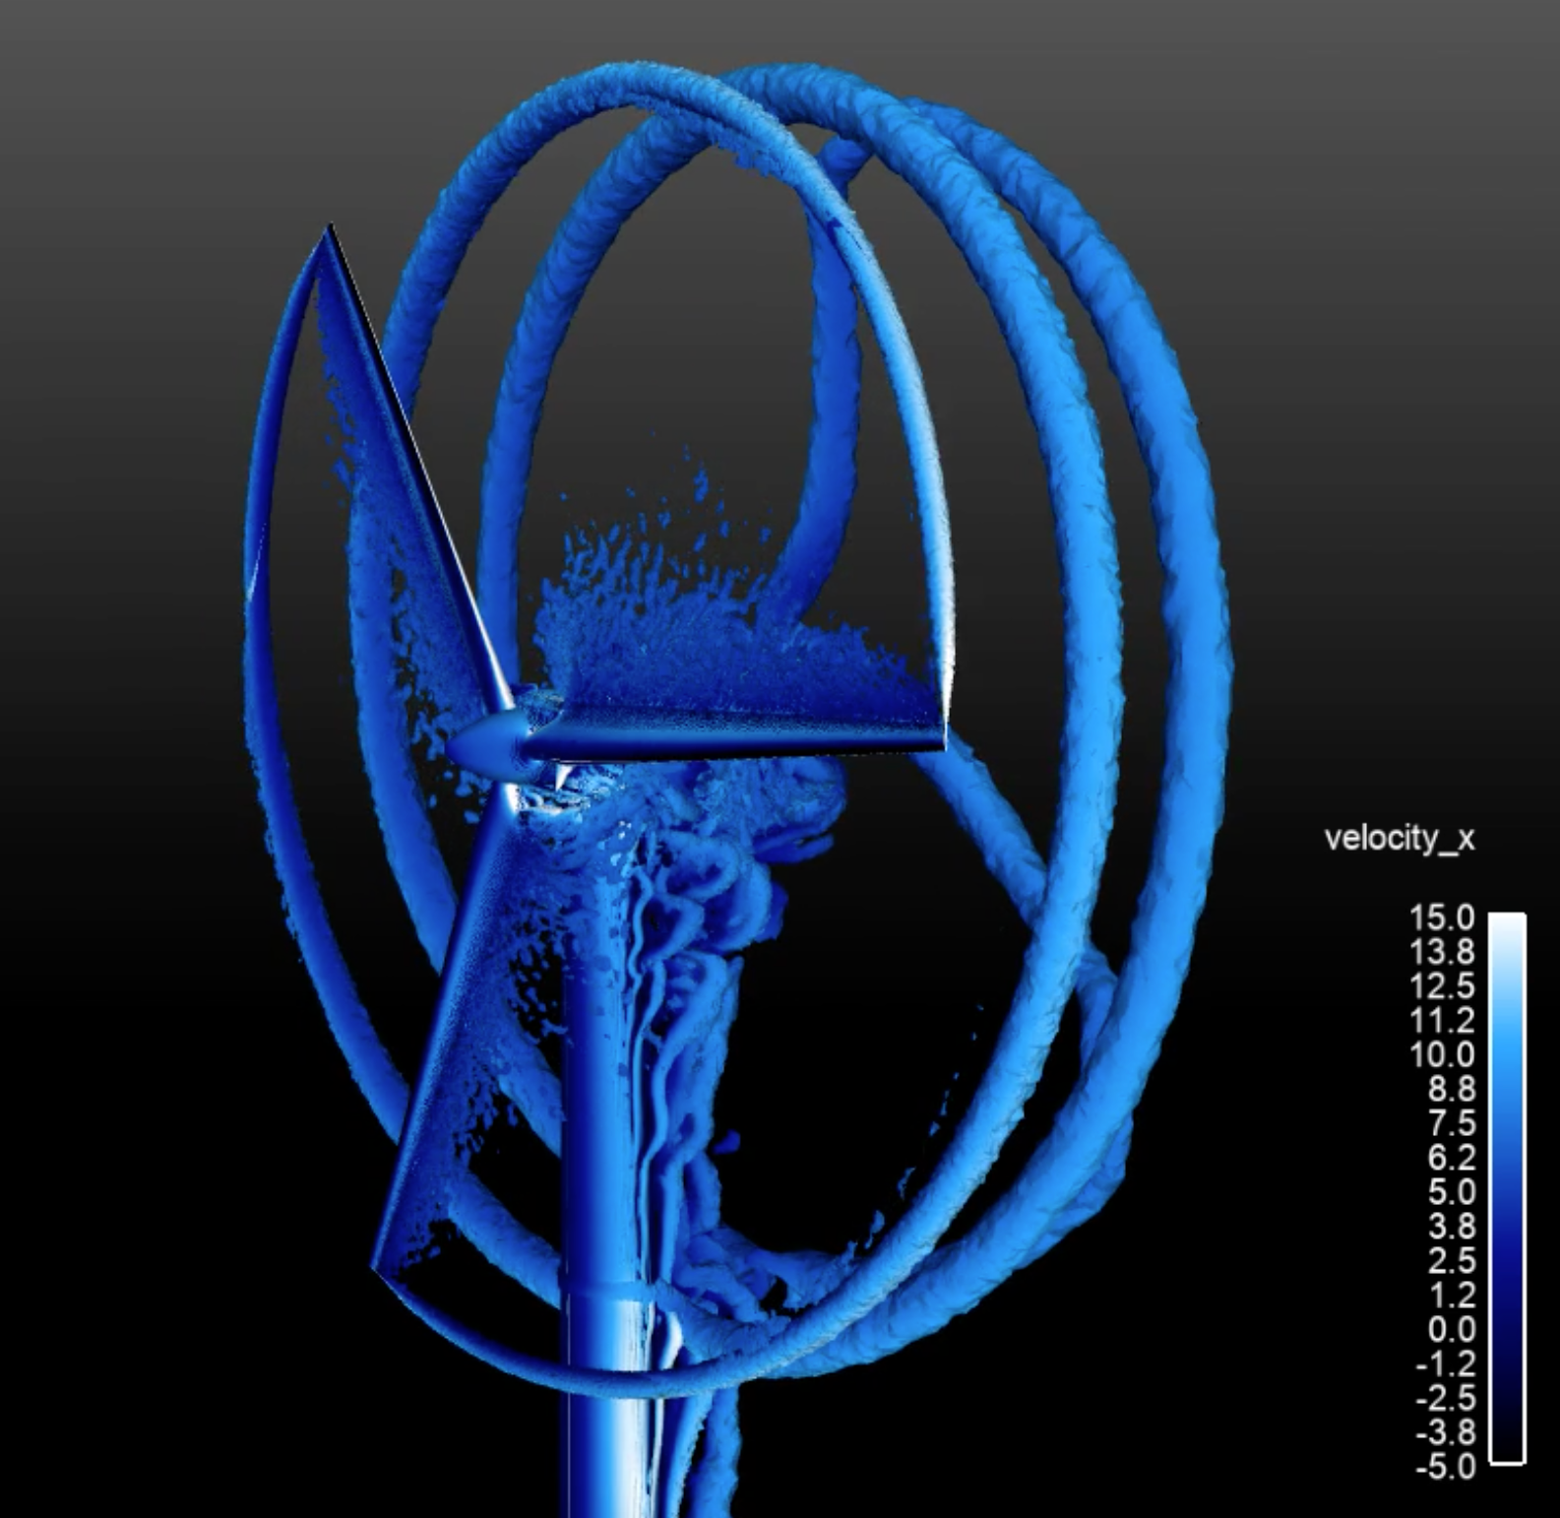
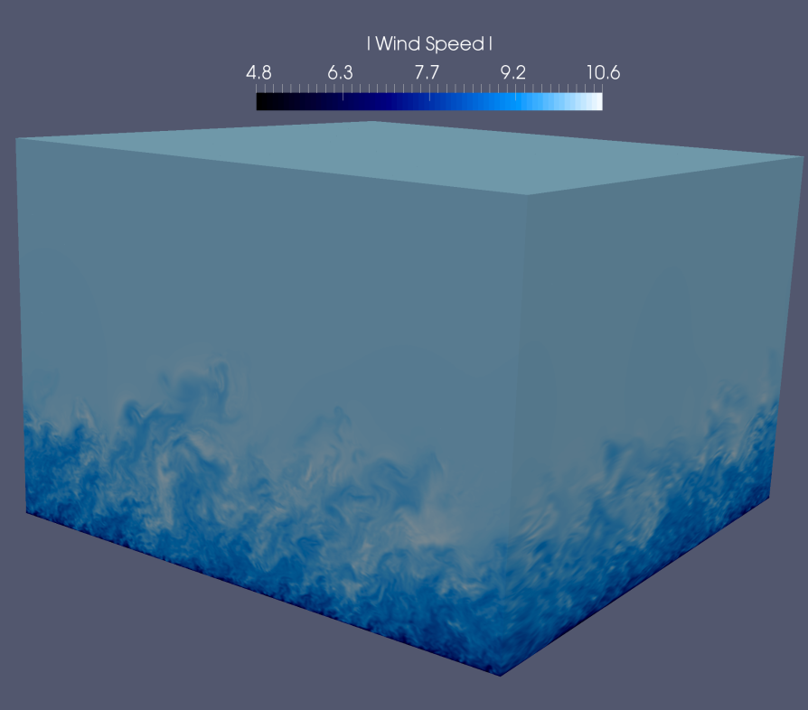
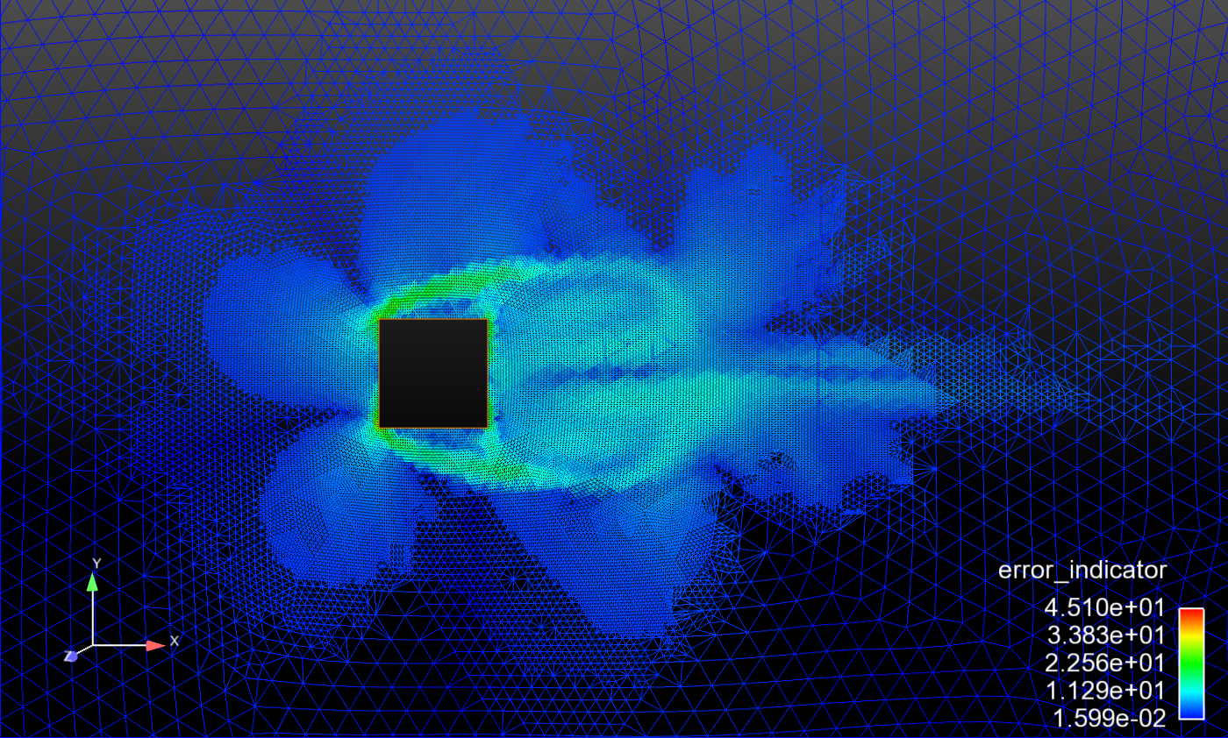
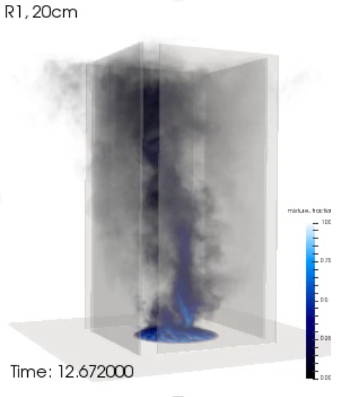
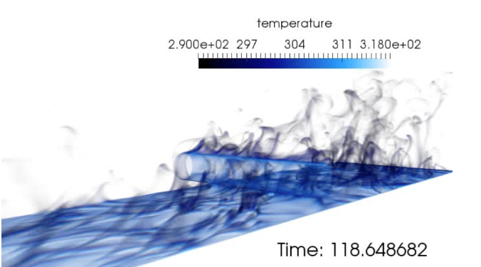
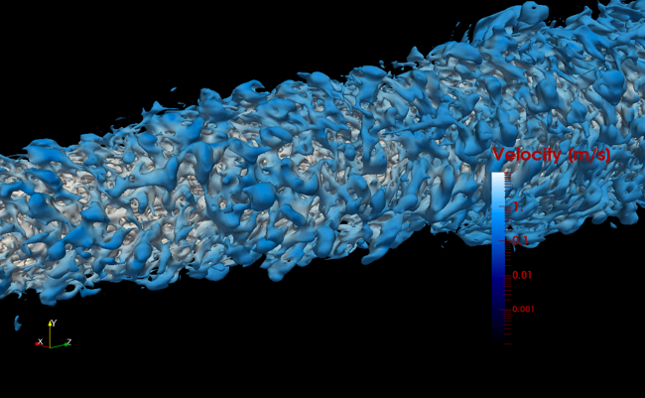
Supported Physics: DNS and LES (even RANS)

Slide 7
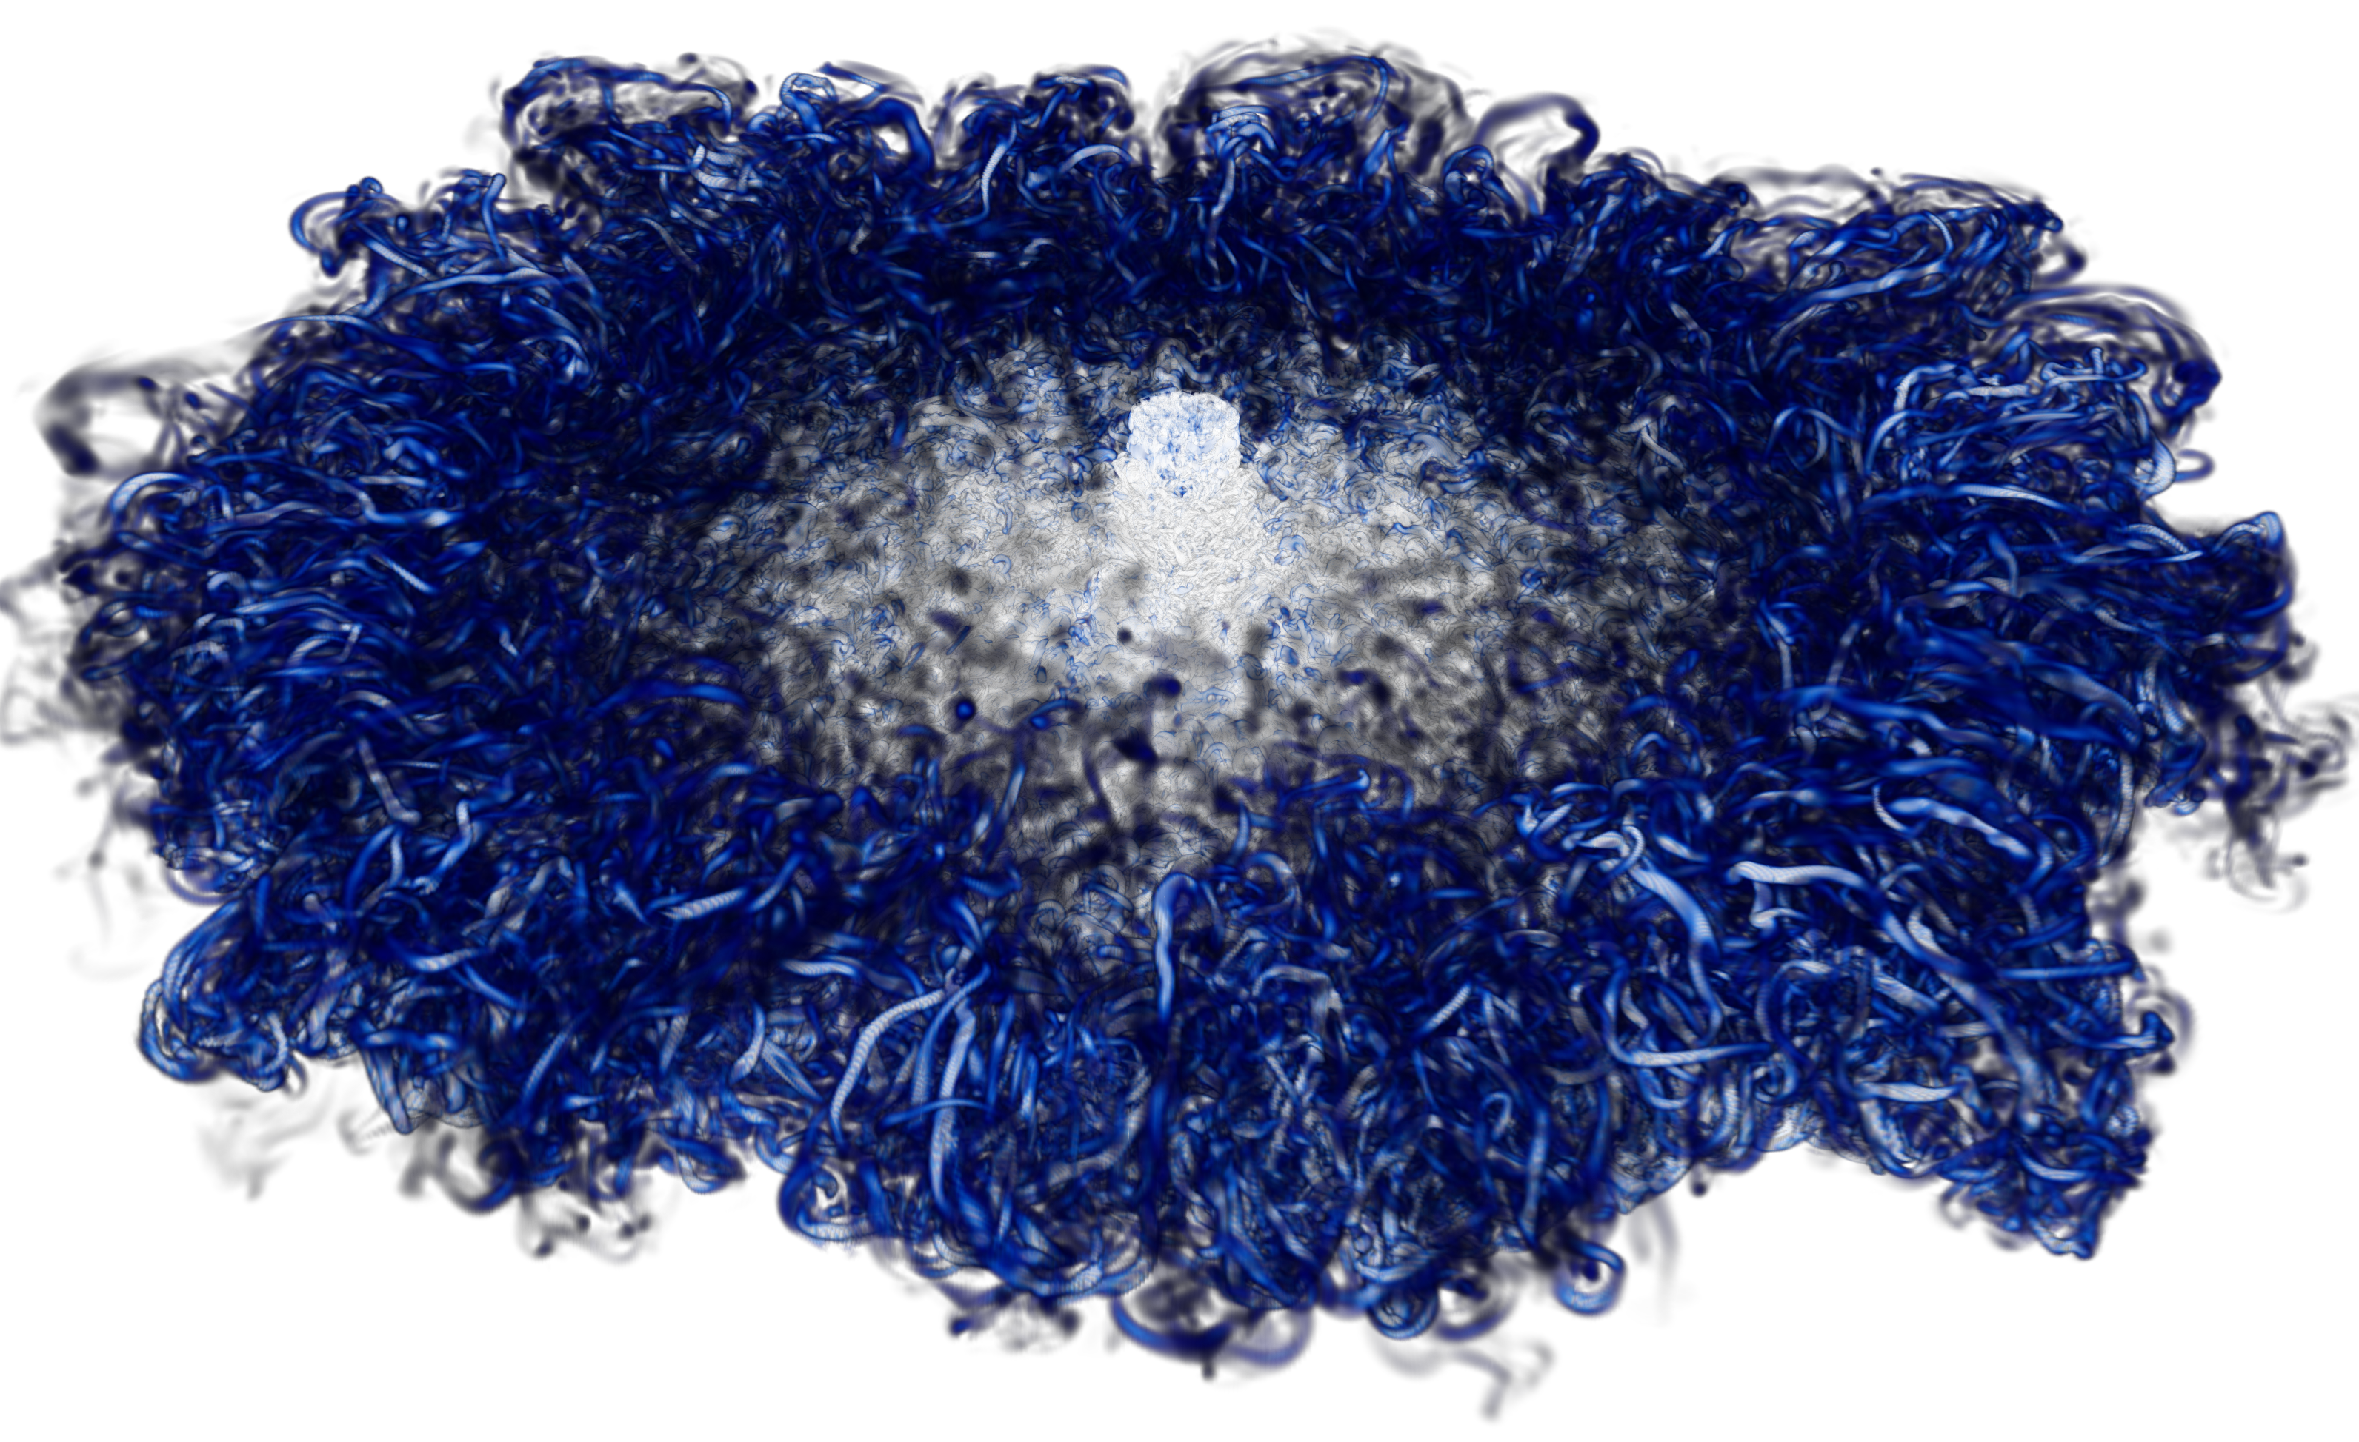
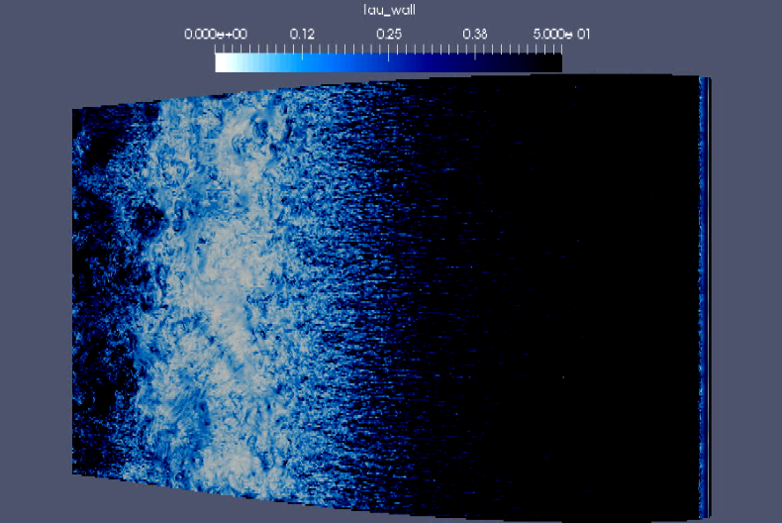
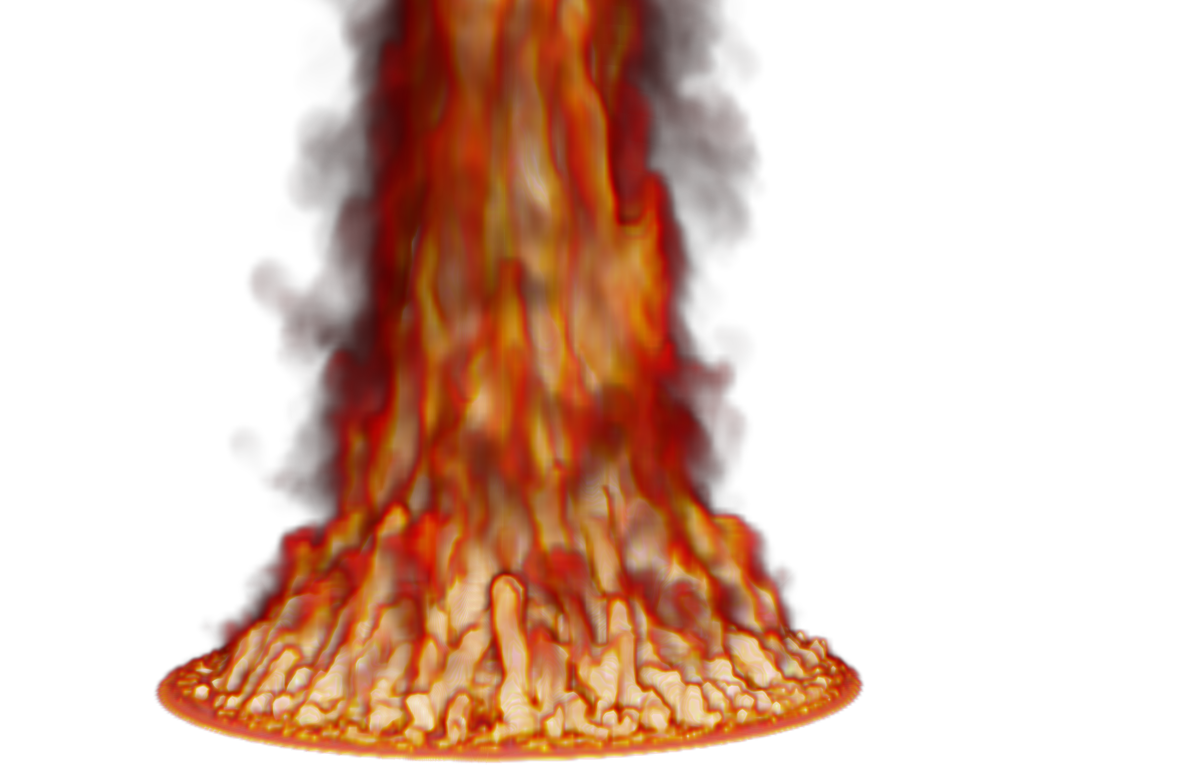
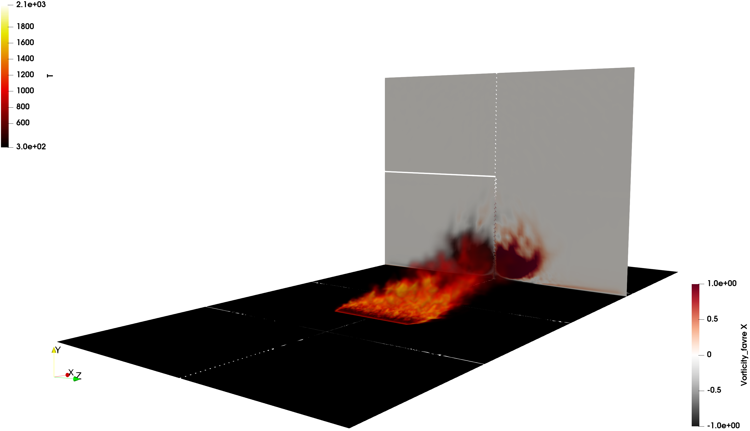

A Note on High Performance Computing
Sandia is committed to High Performance Computing (HPC) to support is science and engineering objectives: Exercised herein
O(2) billion DNS impinging jet
O(200) million multi-physics fire
O(6) billion wind energy application

Slide 8
High Performance Computing: Working in Parallel
Late Roman Timeline 250 AD - 300 AD
250 AD: The Goths invade Anatolia (AKA, Asia Minor), in sea-borne raids they plunder Nikopolis
Trinity open-science time, Domino and Barone, 2016 SAND2016-4085C to elucidate stall cells
O(6) billion element wind energy application (high-Re flow past thick blade in high AoA
O(128,0000) core run for ~one week ~1800 year simulation using computing resources available 10-years ago: Complete in roughly 29 years!

Slide 9
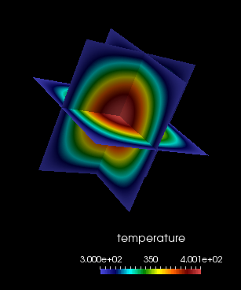
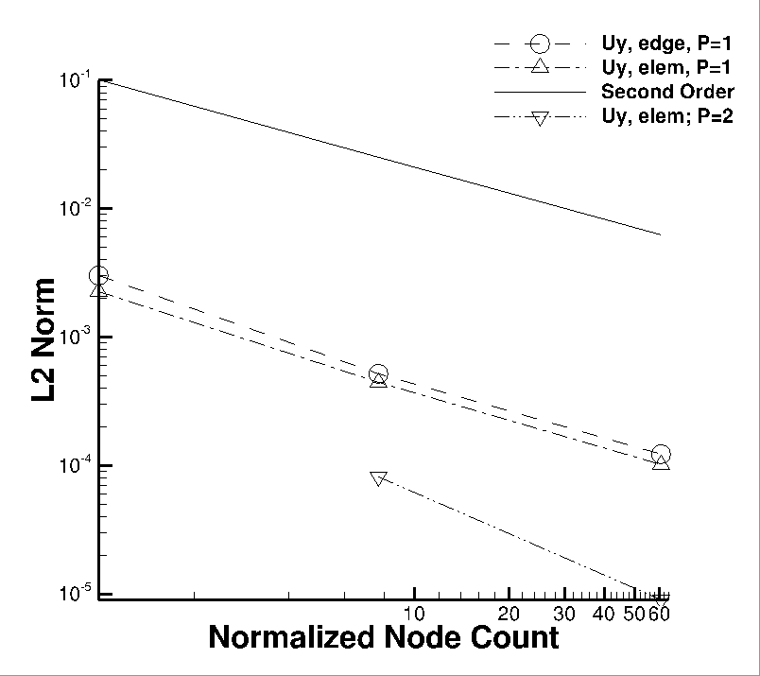
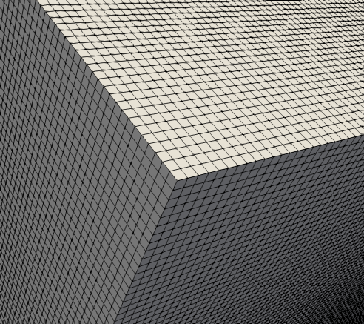
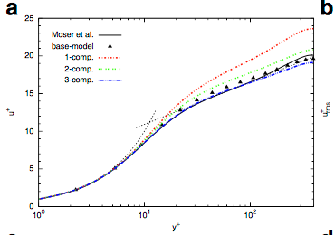
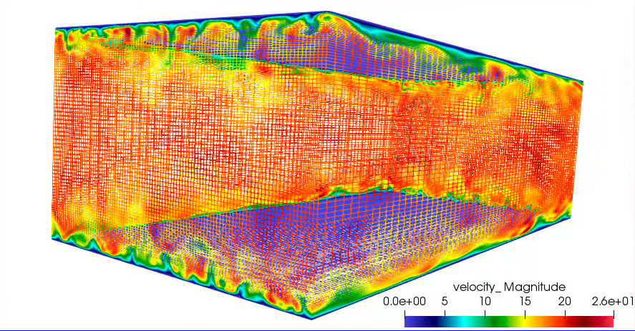
Change of Philosophy: Former Approach
Verify on nice Hexahedral-based elements
Validate on perfect meshes on a variety of canonical flows
Variable-density low-Mach MMS (Domino, CTRSP, 2016)
Re^{τ} 395 plane-channel (Jofre, Domino, Iaccarino, Flow, Turb. & Comb., 2018)

Slide 10
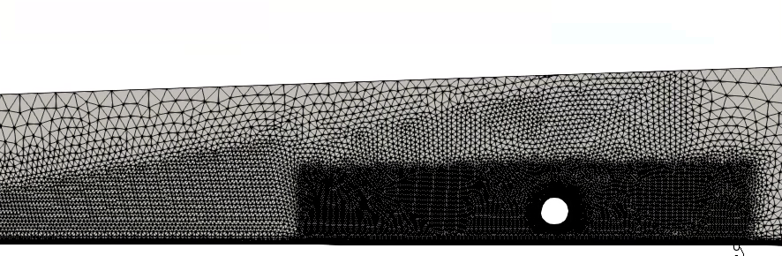

Paradigm Shift: Verify and Deploy High-Quality Unstructured Numerical Methods
Verify on awful hybrid mesh element quality
Validate on non-ideal meshes on a variety of canonical flows
P1/P1
P2/P2
P1/P2
P2/P1
Domino, J. Comp. Phys. Flow, 2018

Slide 11
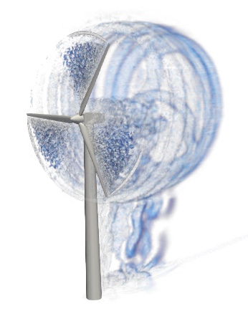
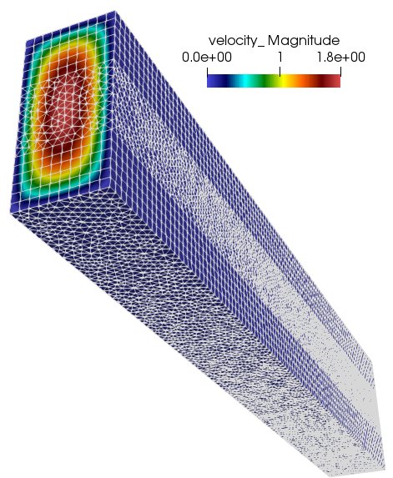
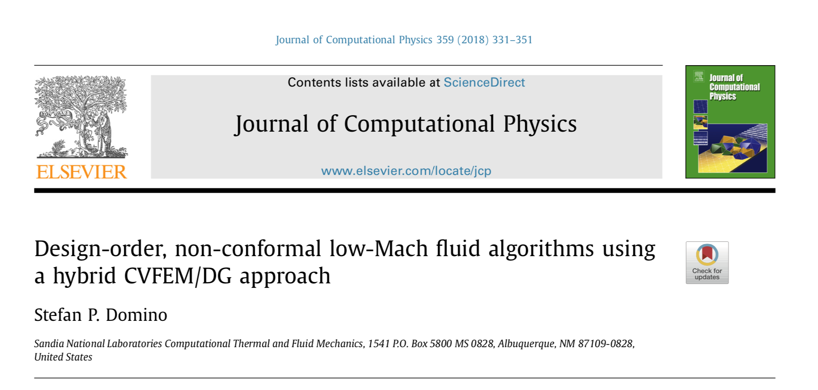
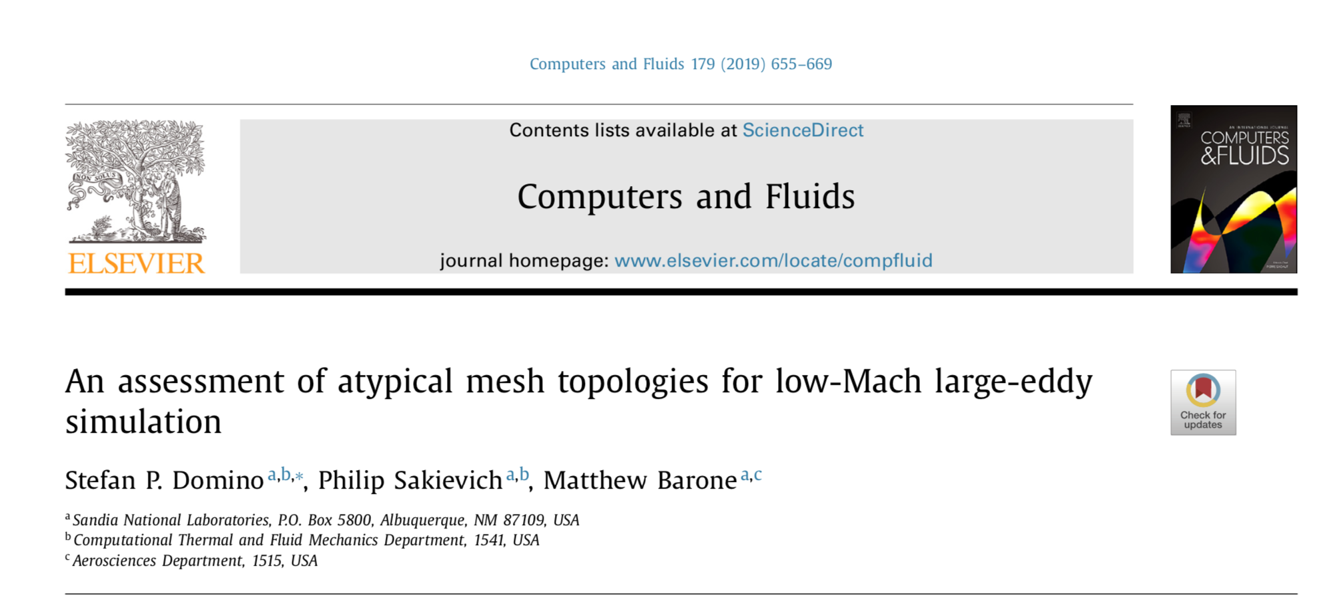
Confidence Established for Atypical Element Topos
Verification
Validation

Slide 12
Nalu History
A time-history of the Nalu code base:
By CFD standards, this is a relatively new code base
Sierra/Nalu
SNL License
Open-source
BSD License (2014)
Github
Nalu
Active
academic partners
ECP ExaWind (2018)
Github
Nalu-Wind
Open-source: SNL, NREL, ORNL, UT joint copyright

Slide 13
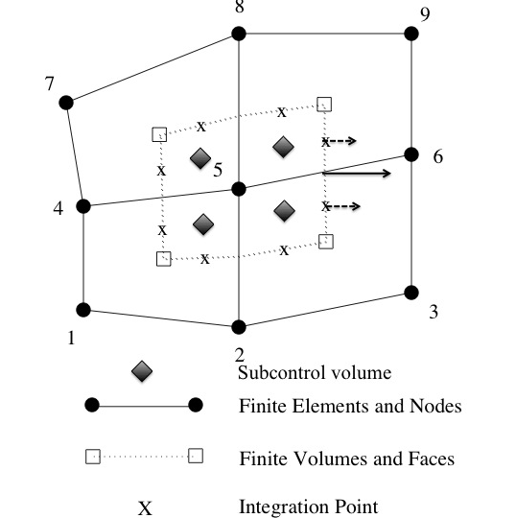
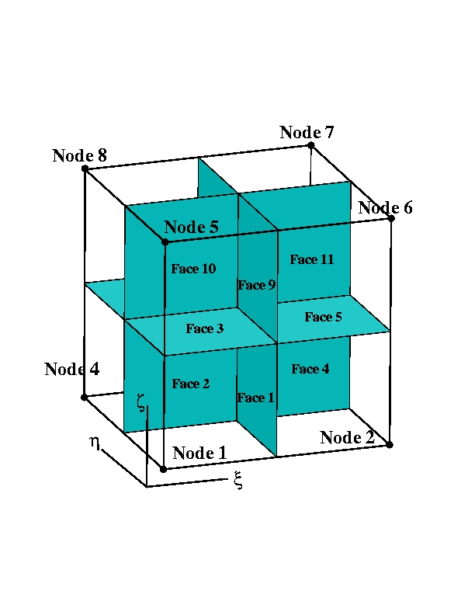
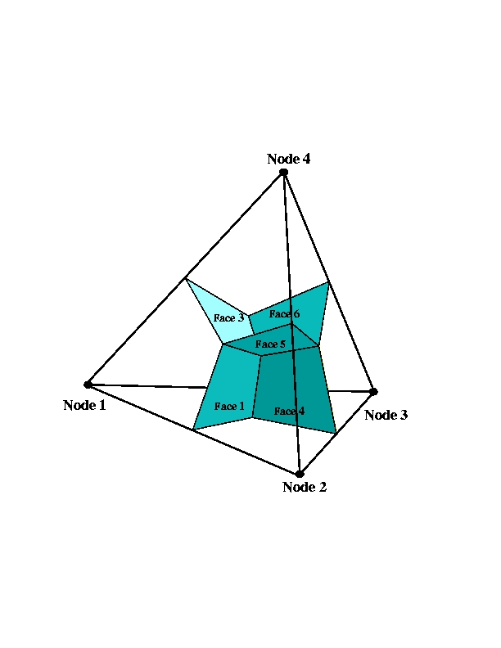
Supported Discretizations: CVFEM/FEM/EBVC
The core discretization used in the low Mach code base has been the Control Volume Finite Element Method, CVFEM
Finite Element Method and Edge-based Vertex-Centered, EBVC, are also supported

Slide 14
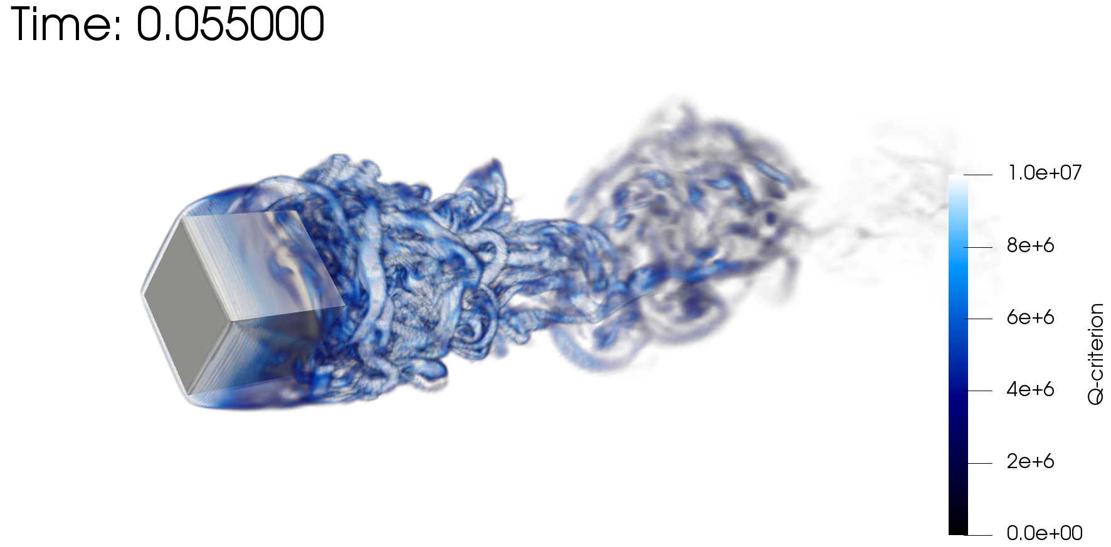

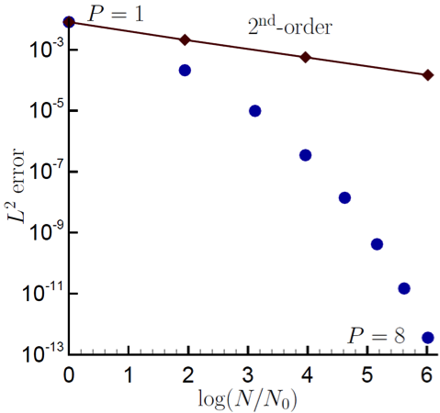
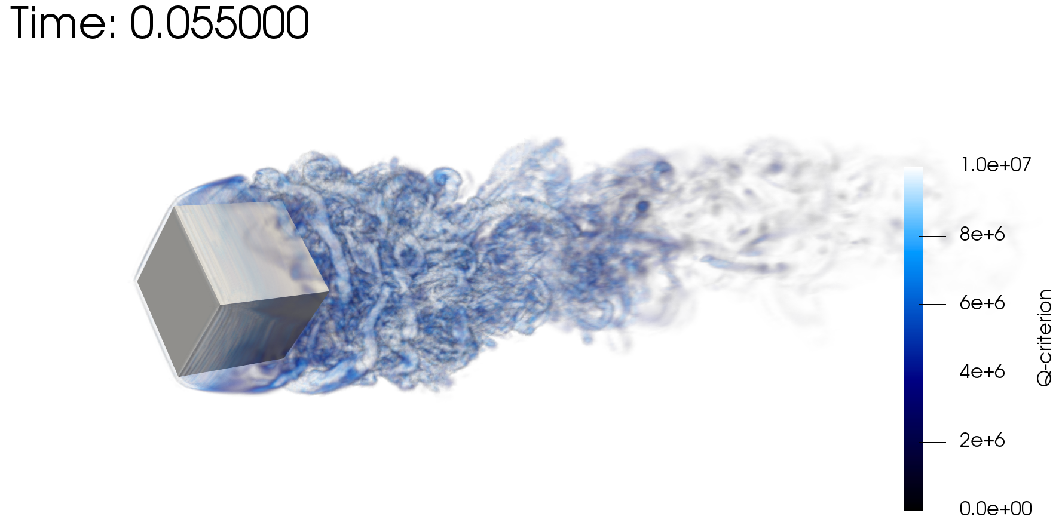
Scientific Research Platform to Evaluate Higher-Order Methods on Next Generation Platforms
As the cost of parallel assembly increases, should we strive to perform more local work? Higher-order achieves this design-point (at the cost of a larger memory footprint)
Spectral convergence
Dual-volume
for promoted quad4
Flow-past rotating cube
Re~4000, RPM~3200
Same node count,
P=1 (top) P=2 (bot)

Slide 15

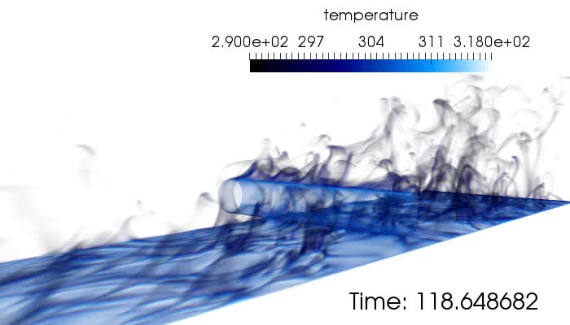
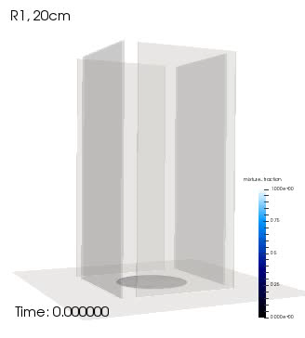
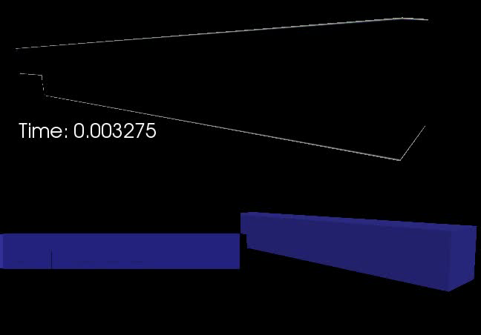
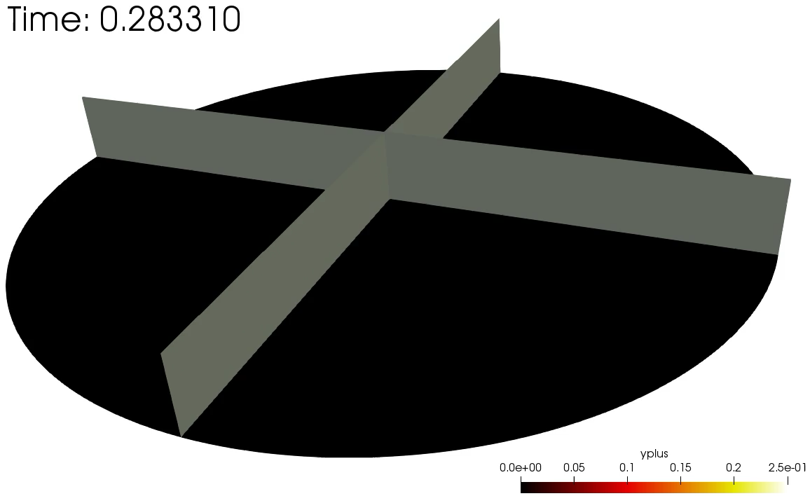
Several Multi-physics Flow Examples From Nalu
Cylinder in cross flow
Helium plume (low-/high-order)
Heated backstep
Whirling behavior
Impinging Jet DNS

Slide 16
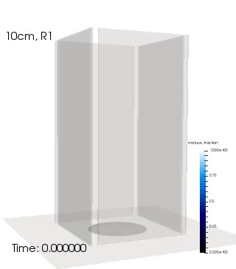
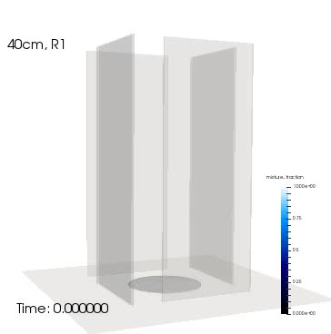
Evolution of a Mindset….. Modeling Whirling-like Flow
SAND2019-7052 C
Idealized chamber in which swirl is provided by selective wall placement in the experimental design
Gap varied between 10, 20, and 40 cm
Objective: Can the onset of swirl be predicted? What is the strength?
Volume rendered mixture fraction
Notes:
Fire whirls are complex phenomena that we are just understanding and, only recently, can model.
This is an example where we have engineered slots in walls that inspire vortical flow in the inner chamber. The plume accelerates upward and, therefore, entrains fluid. The slots provide a large-scale clockwise rotation.

Slide 17
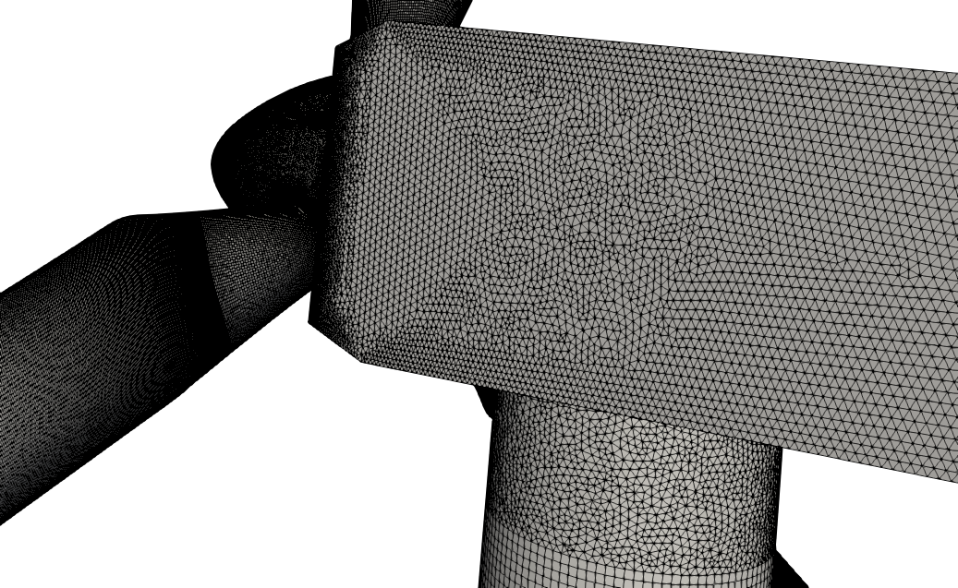
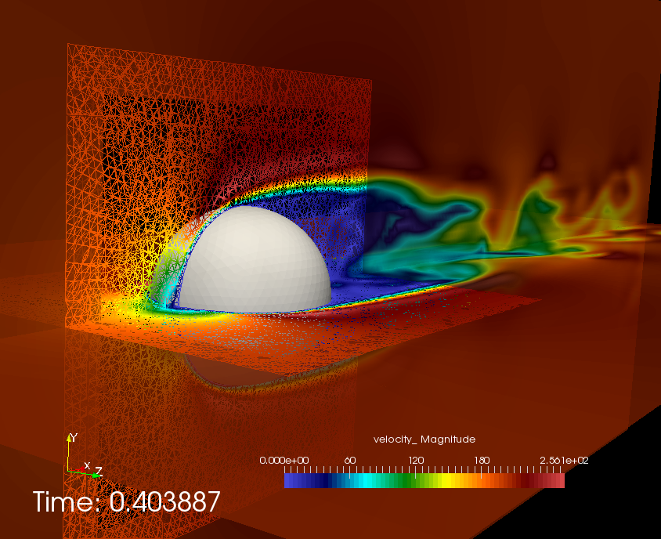
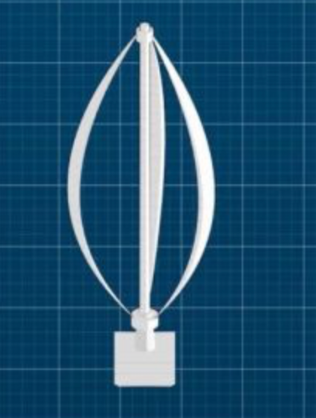
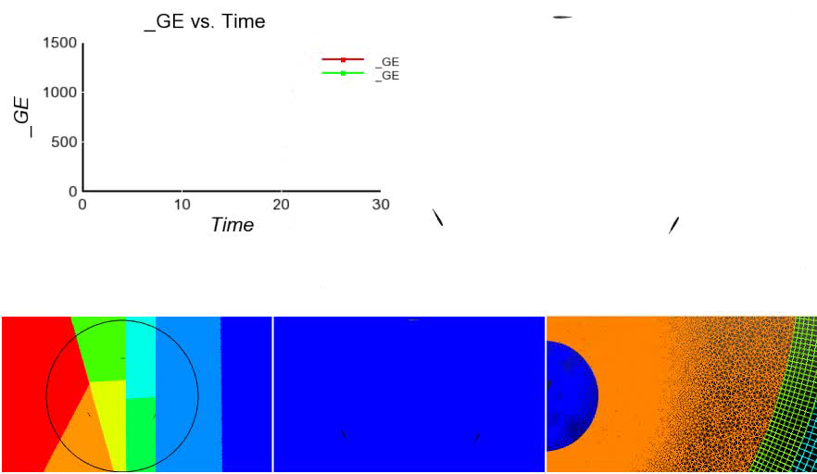
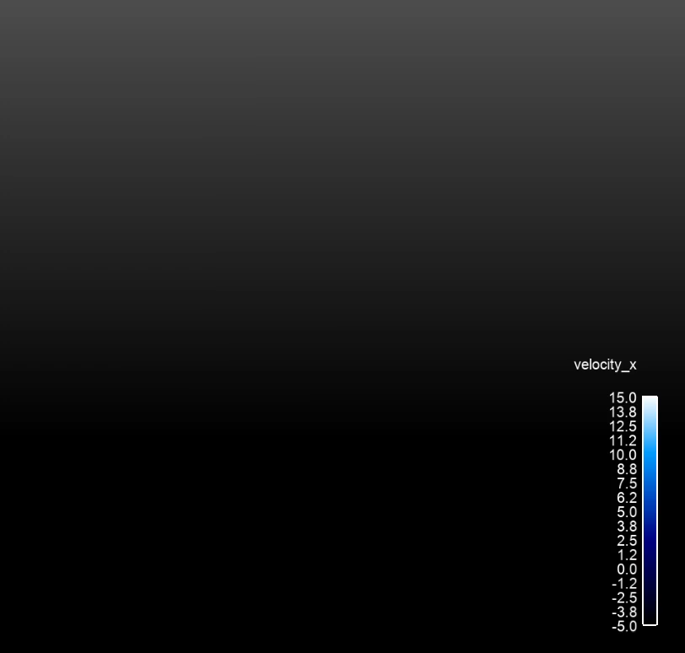
Unique Complex Geometry Use-Cases
Low-dissipation methods with suitable nonlinear stabilization operators using sliding and overset technologies to aid modeling effort and/or meshing
Objective: Design-order established/verified implementations on generalized, unstructured, hybrid meshes
Vertical Axis Wind Turbine
(VAWT)
Horizontal Axis Wind Turbine
(HAWT)

Slide 18
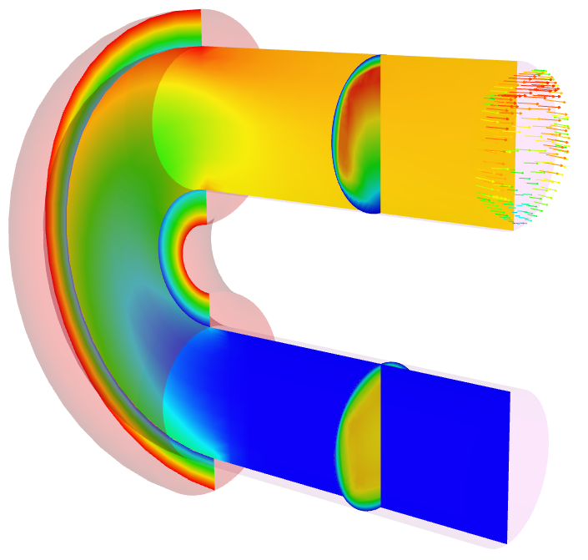
Nalu Abstractions: Polymorphic and Input File-Driven
Time Integration
Nonlinear Coupling
Domain
Realm A
Realm B
1 to many
Interior
algorithms
1 to many
Interior
algorithms
1 to many
boundary
algorithms
1 to many
boundary
algorithms
Transfer
Realm specifications define the physics and desired boundary conditions
Pre-defined EquationSystems (segregated or monolithic)
Operator-split multi-physics
Conjugate heat transfer coupling
Fluids Realm
Heat Conduction Realm

Slide 19
30K View: Anatomy of a Nalu Input File:YAML-based
Simulation:
linear_solvers:
transfers:
realms:
- name: realm_heatCond
boundary_conditions:
- wall_boundary_condition: bc_exposed
solution_options:
initial_conditions:
material_properties:
equation_systems:
systems:
- HeatConduction:
output:
restart:
- name: realm_fluids
TimeIntegrators:
Specification of sparse Trilinos-based precond/solver
Data transfer for multi-physics coupling
YAML enforces strict spacing and ordering
https://www.democraticunderground.com/10021540110
Physics definitions
Time integration, e.g., BE, BDF2

Slide 20
High-Level Elements of an Input File
systems:
- LowMachEOM:
name: myLowMach
- MixtureFraction:
name: myZ
initial_conditions:
- constant: ic_1
target_name: [block_1, …]
value:
pressure: 0
velocity: [0.5,0.0]
mixture_fraction: 0.0
boundary_conditions:
- inflow_boundary_condition: bc_left_inflow
- wall_boundary_condition: bc_front_wall
- open_boundary_condition: bc_right_open
- symmetry_boundary_condition: bc_top
- nonconformal_boundary_condition: bc_nc
material_properties:
target_name: block_1
specifications:
- name: density
type: constant
value: 1.0
- name: viscosity
type: constant
value: 1.8e-5
material_properties:
target_name: block_1
specifications:
- name: density
type: ideal_gas
- name: viscosity
type: polynomial
coefficient_declaration:
- inflow_boundary_condition: bc_left
target_name: surface_1
inflow_user_data:
velocity: [0.5,0.0,0.0]
mixture_fraction: 0.0
- wall_boundary_condition: bc_back
target_name: surface_7
wall_user_data:
user_function_name:
velocity: wind_energy
user_function_string_parameters:
velocity: [mmTop_ss7]
mixture_fraction: 1.0

Slide 21
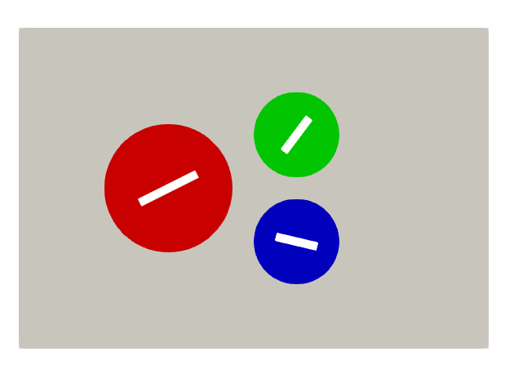
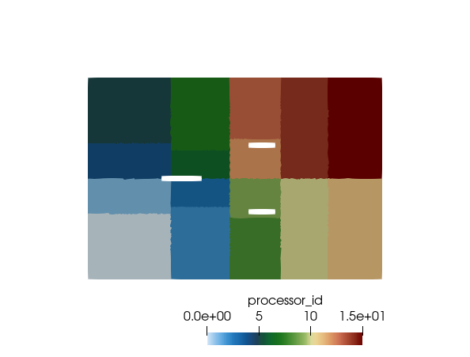
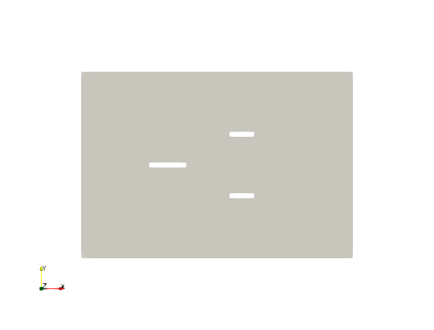
A Note on Parallel Decomposition
As noted, decomposing the mesh into small subsets and operating on these subsets in parallel provides a methodology for increased simulation time
Colored by block ID
Colored by core count (= 1) One mpi rank. 16 MPI ranks = 16x faster (hopefully)

Slide 22
How to Run in Parallel: Mesh Decomposition
Given a mesh, mesh.g and myInputFile.i, if one desires to run on, e.g., 16 core case:
Use pre-processing “decomposition” tools (Trilinos/install/bin)
In-situ
>/path/to/decomp –j {np} {meshName}
>mesh.g.16.00, mesh.g.16.01, .., mesh.g.16.15
1:
- name: realmFluids
mesh: mesh/myMesh.g
automatic_decomposition_type: rcb
myMesh.g
- name: realmFluids
mesh: mesh/myMesh.g
automatic_decomposition_type: rcb
2:
>mpirun --np 16 /naluPath/naluX -i input.i &
>results.e.16.00, results.e.16.01, .., results.e.16.15
>input.log

Slide 23
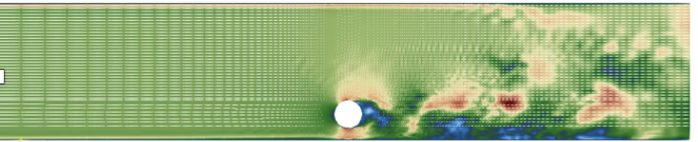



A Note on Divergence
Whether by design or poor code usage, solution results from CFD analysis for complex applications may diverge. How do I know?
Non-finite residuals, i.e., not-a-number:“nan” (either linear or non-linear),
const double norm = 0.0;
const double flux = rho*u*A/norm;
Simulation runs, however, results look very wrong
Typical causes?
Bad initial condition that drives nonlinear solution to diverge
Too large of an initial time step
Poor stabilization, numerical parameters, etc.
Poor time integration
Ph.D. from ICME explaining why…
EBVC flow-past 2D cylinder
Top: +NOC
Bottom se: -NOC

Slide 24
Test Case Input Files
All input files are part of the Nalu regression test suite: Nalu/reg_test/test_files
Mesh files are found under: Nalu/reg_test/mesh
Formally, /mesh is a git submodule
Test Cases Highlighted:
Nalu/reg_tests/test_files/dgNonConformalThreeBlade
Nalu/reg_tests/test_files/fluidsPmrChtPeriodic
Homework #1:
https://github.com/spdomin/Present/tree/master/standformMe469/hwOne
Feel free to run any case that you feel looks interesting to you!
Note that the regression test suite is (mostly) focused on providing code coverage and may not represent “sane” physics-based choices
Resource: https://nalu.readthedocs.io/en/latest/source/theory/index.html

Slide 25
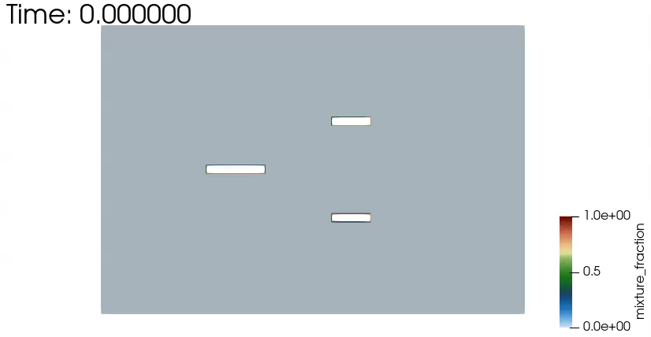
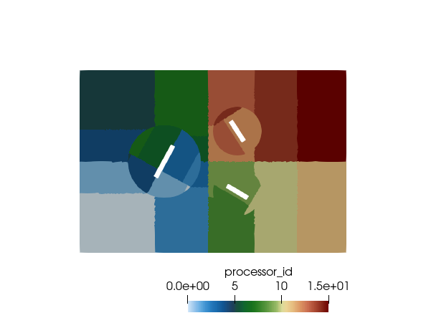
Nalu/reg_tests/test_files/dgNonConformalThreeBlade
Physics
Flow past rotating square blades (Re = 10,000)
Models
Newtonian fluid (air) with constant properties
Boundary Conditions
Inflow, open, symmetry, DG/CVFEM interface
Domino, JCP, 2018
>mpirun --np 4 /naluPath/naluX -i dgNonConformalThreeBlade.i &

Slide 26
Nalu/reg_tests/test_files/dgNonConformalThreeBlade
UΔt/Δx
γ_{i} for BDF2
Time Step Count: 7 Current Time: 0.0127268
dtN: 0.00266002 dtNm1: 0.00231306 gammas: 1.53488 -2.15 0.615116
Max Courant: 1.54421 Max Reynolds: 236.792 (realm_1)
Realm Nonlinear Iteration: 1/1
realm_1::advance_time_step()
NLI Name Linear Iter Linear Res NLinear Res Scaled NLR
--- ---- ----------- ---------- ----------- ----------
1/2 Equation System Iteration
1/1 myLowMach
MomentumEQS 4 1.27653e-07 0.000173716 1
ContinuityEQS 9 5.17721e-06 0.00618278 1
PNGradPEQS 19 4.2818e-09 2.78318e-06 1
PNGradUEQS 20 9.70201e-09 5.20951e-06 1
1/1 myZ
MixtureFractionEQS 5 1.31346e-09 6.84724e-06 1
PNGradZEQS 5 6.33586e-09 3.66957e-06 1
2/2 Equation System Iteration
1/1 myLowMach
MomentumEQS 5 8.33682e-10 2.23818e-06 0.0128842
Mass Balance Review:
Density accumulation: 0
Integrated inflow: -0.375
Integrated open: 0.3749998354138842
Total mass closure: -1.64586e-07
Mean System Norm: 0.0002458198407611864 7 0.0127268
ρ U L / μ
equations
nonlinear
iterations
Review

Slide 27
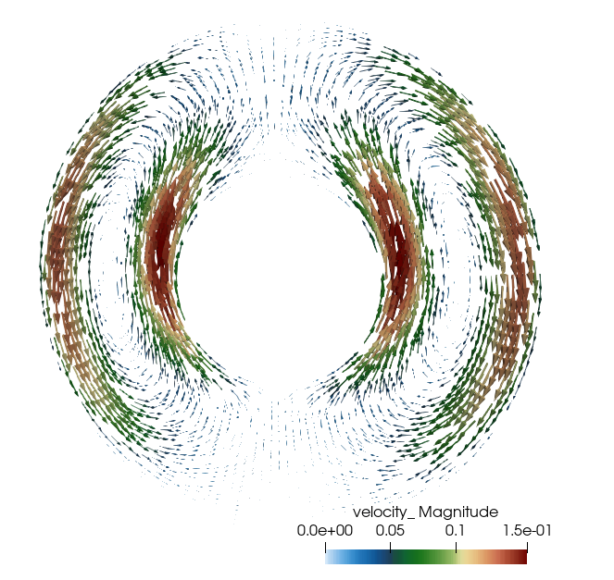
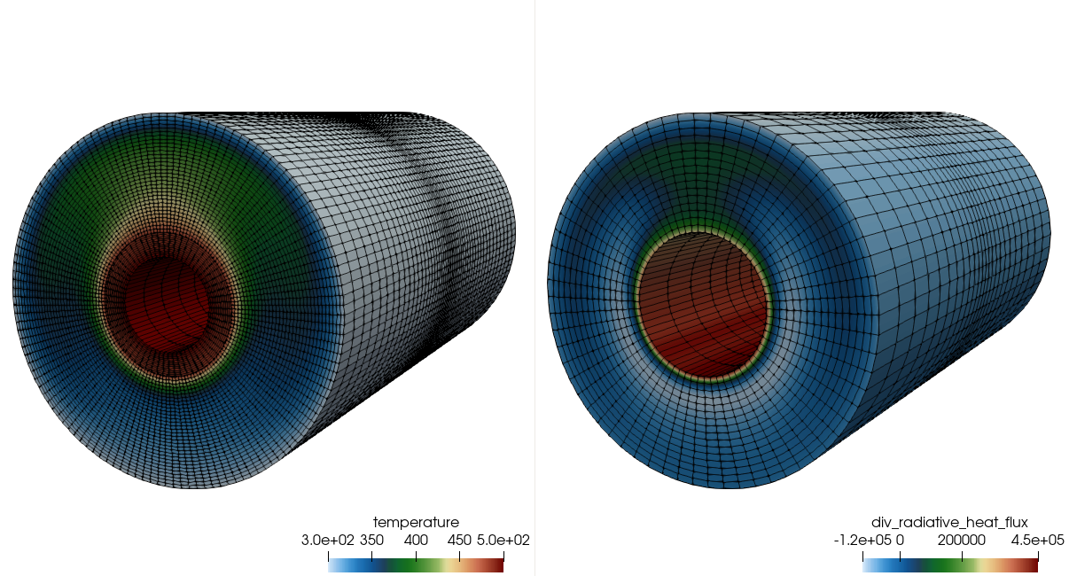
Nalu/reg_tests/test_files/fluidsPmrChtPeriodic
Physics
Uniformly emitting/absorbing participating media radiation (PMR) conjugate heat transfer (CHT) with buoyancy
Models
Newtonian fluid (air): ideal gas
Boundary Conditions
Wall, periodic
Stark#, cond/rad
Sk = λ μ / σ T_{i}³ ~ 0.4
Rayleigh#, τ^{ThermalDiff}/ τ^{Conv}
Ra = g β (T_{i} – T_{o} ) L / Pr α² ~ 2e6
>mpirun --np 8 /naluPath/naluX -i fluidsPmrChtPeriodic.i &

Slide 28
Nalu/reg_tests/test_files/fluidsPmrChtPeriodic
Temperature
Irradiation
Conduction
Heat Transfer,
Enclosure Radiation
SURFACE
Participating
Media
Radiation DOM
STK
Transfer
Temperature, μ_{g}
RTE Src
Linearized
Temperature
Convection Coef.
Reference Temp
SURFACE
۰q_{r}
VOLUME
Δ
Turbulent
Fluid Mechanics,
Combustion
Monolithic, i.e., fully coupled, approaches are intractable due to the size of (u, v, w, p, h, h^{r}, Z, I^{k} T)^{T}
Stable and accurate operator split methods are, therefore, sought
See Domino et al., AIAA, 2007

Slide 29

Laminar Pipe Flow: Specified Pressure Drop for Re^{τ}= 10
Physics
Laminar pipe flow (specified pressure drop)
Models
Newtonian fluid (air): ideal gas
Boundary Conditions
Wall, open (pressure specified)
Location: https://github.com/spdomin/Present/tree/master/stanfordMe469/hw/one
Specifications:
Re^{τ} = 10
Pipe diameter, D = 0.01 m
Pipe Length, L = 0.2 m
ρ = TBD
μ = TBD
dp/dz = TBD
Uc = TBD

Slide 30
Break-out Example Using Paraview
Live in-class demo

Slide 31
Nalu Overview: Conclusion
Nalu’s technology has its roots in the ASC Sierra/Fuego effort
Multi-physics capabilities are in development
Research platform for high-order low-Mach methods
Open-source collaboration model
Multi-physics by design (operator split)
Funded through ASC, ECP, A2e, ASCR, and LDRD
Elements of an input file
Solvers, mesh, equations, material models, boundary conditions, etc.
The need for parallel computing
Examples
Fixed rotation for three blades
Thermal/PMR/Fluids
Paraview to visualize

